Slide 1
Did You Know? POLITICAL PARTIES IN ONTARIO

Slide 2
Ontario's Main Political Parties
?
Green Party of Ontario
New Democratic Party of Ontario (NDP) Ontario Liberal Party Progressive Conservative Party of Ontario (PC)

Slide 3
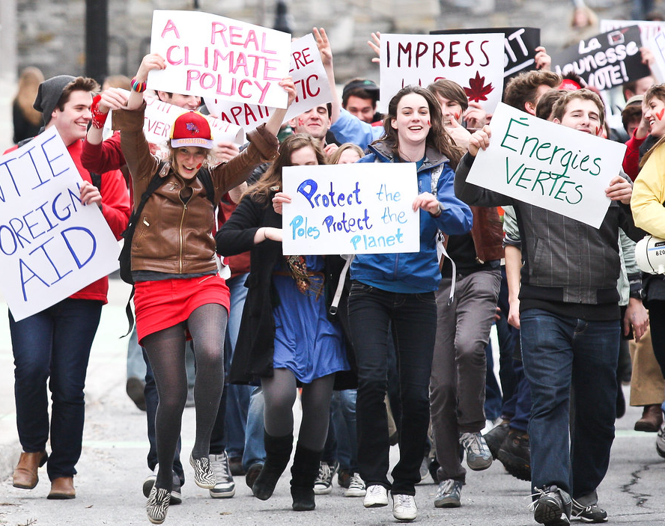
How can youth get involved with political parties?
The minimum age to join a political party varies from party to party in Ontario from a minimum of 14 to 16 years old
You can become a member with all the rights that come with it, including voting for party leader
Check online for the youth division of a political party if you are interested!

Slide 4
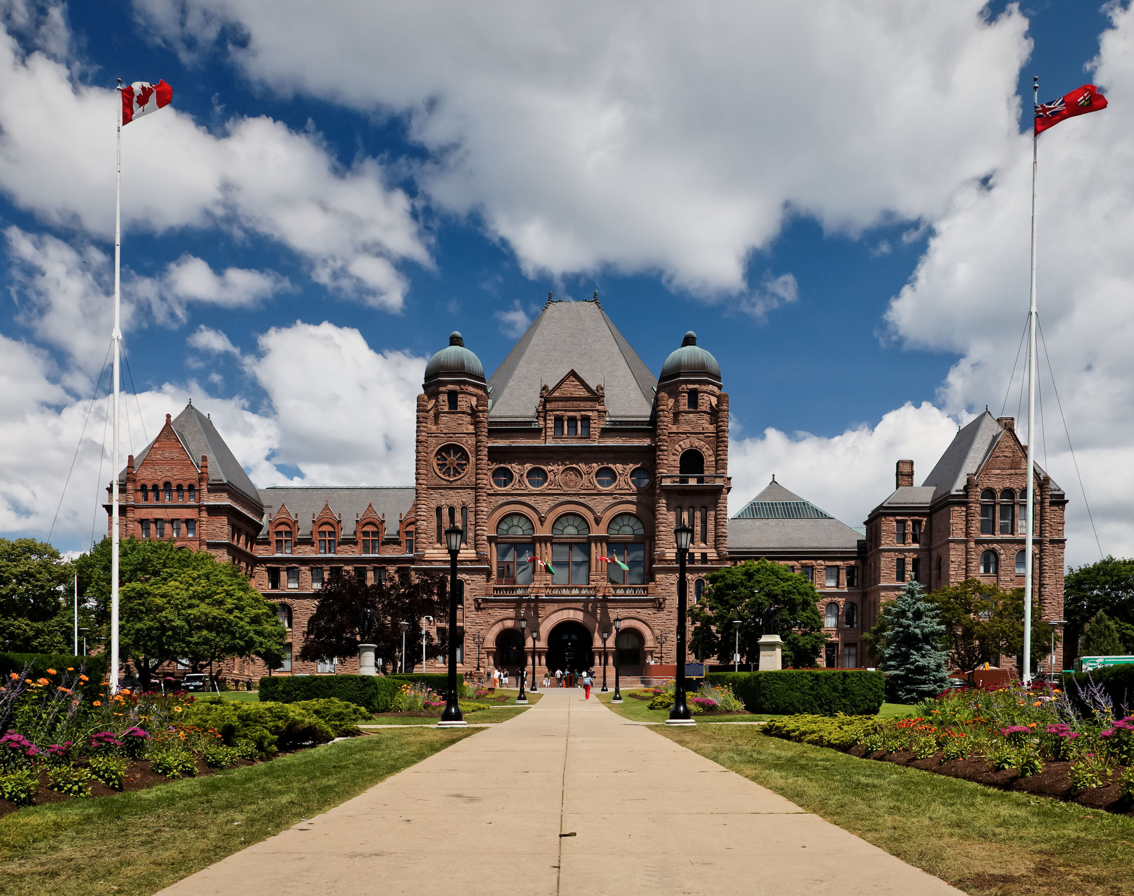
Who gets to be Premier of Ontario?
Who gets to be Premier of Ontario?
Party members elect the party leader
Different parties have different methods for electing their party leaders
Very few Ontarians actually belong to a political party!
In a general election, electors vote for a candidate from a party; the party with the most votes wins. The leader of the party becomes Premier
Party members elect the party leader
Different parties have different methods for electing their party leaders
Very few Ontarians actually belong to a political party!
In a general election, electors vote for a candidate from a party; the party with the most votes wins. The leader of the party becomes Premier
Queen's Park, Ontario Legislature

Slide 5
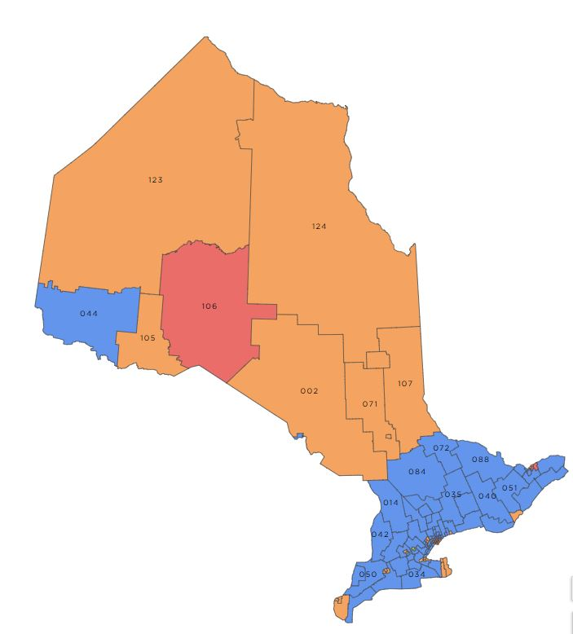
Provincial vs Federal
In general, Ontario's provincial parties are not the same at the national level (although they have the same names)
Ontario's provincial parties focus on provincial issues

Slide 6
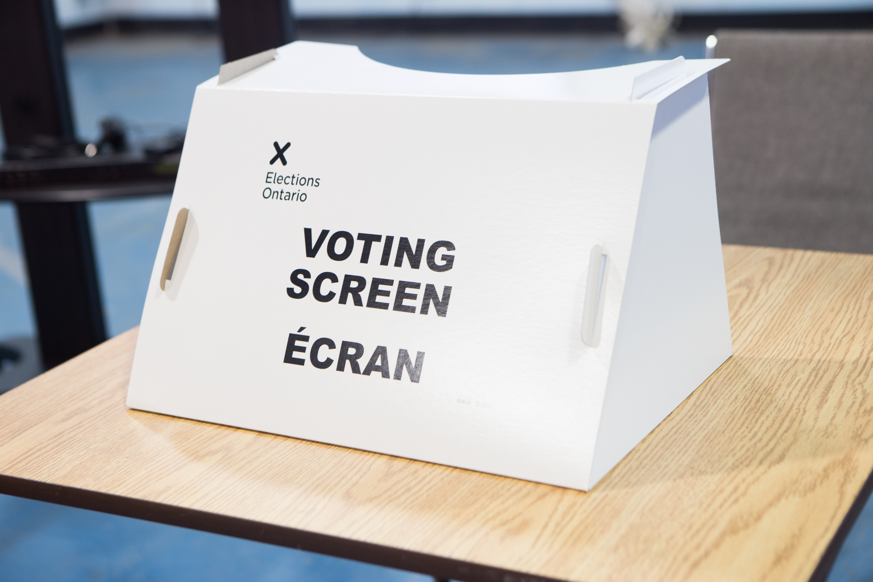
How are political parties formed?
Political parties in Ontario must be registered with Elections Ontario (EO)
There is no fee to register a political party
Elections Ontario reviews the application and registers the name, then a process begins to register the party
View the registration rules on the EO website
Ontario has more than 20 registered parties – check out the list on the EO website

Slide 7
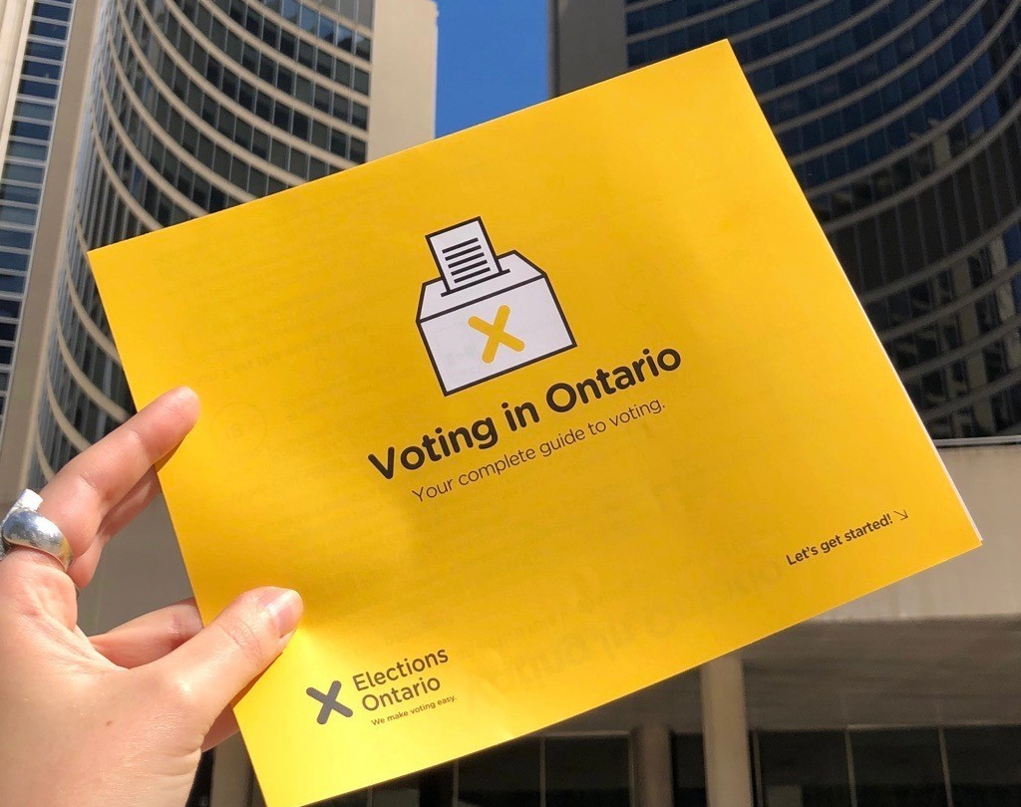
Who makes party rules?
Who makes party rules?
Ontario's political parties maintain their own constitutions
Party members vote on internal party matters
Every party has different rules and processes
The Election Finances Act sets out the laws for the registration of Ontario’s political parties, constituency associations, third parties, candidates and party leadership contestants
During an election, this is the legislation that sets limits on campaign expenses and political contributions, and imposes a time period for advertising
Ontario's political parties maintain their own constitutions
Party members vote on internal party matters
Every party has different rules and processes
The Election Finances Act sets out the laws for the registration of Ontario’s political parties, constituency associations, third parties, candidates and party leadership contestants
During an election, this is the legislation that sets limits on campaign expenses and political contributions, and imposes a time period for advertising

Slide 8
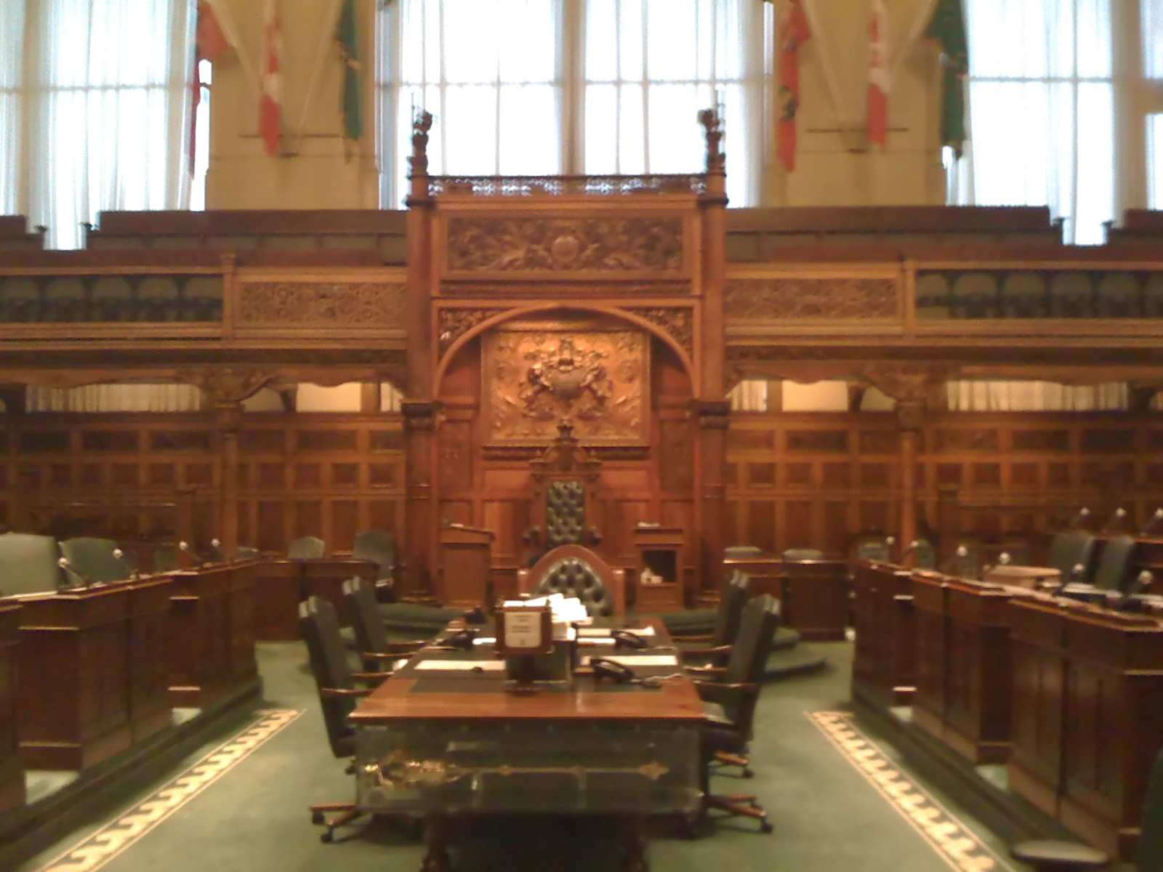
Party Discipline
Party Discipline
Politicians who misbehave can be expelled from the party by the leader
Generally, they finish the rest of their elected term as independent candidates and are not allowed to seek re-election as a member of that party
Politicians who misbehave can be expelled from the party by the leader
Generally, they finish the rest of their elected term as independent candidates and are not allowed to seek re-election as a member of that party

Slide 9
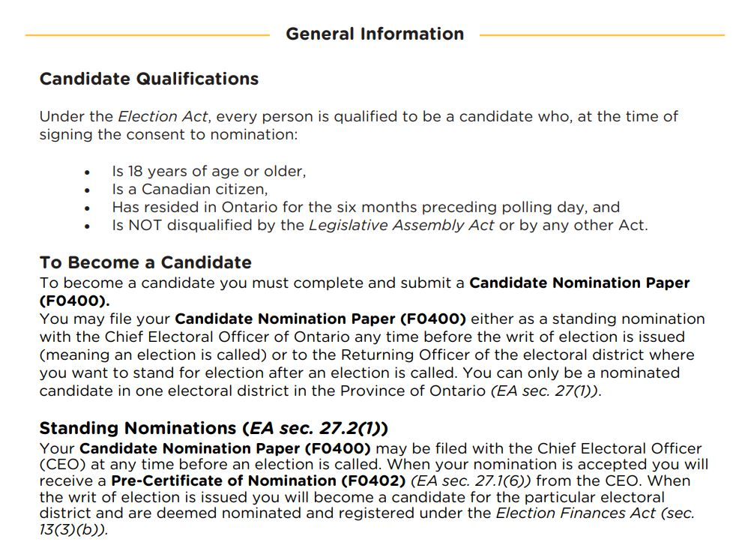
Do you have to belong to a party to run for election?
General Information
Candidate Qualifications
Under the Election Act, every person is qualified to be a candidate who, at the time of signing the consent to nomination:
Is 18 years of age or older,
Is a Canadian citizen,
Has resided in Ontario for the six months preceding polling day, and
Is NOT disqualified by the Legislative Assembly Act or by any other Act.
To Become a Candidate
To become a candidate you must complete and submit a Candidate Nomination Paper (F0400).
You may file your Candidate Nomination paper (F0400) either as a standing nomination with the Chief Electoral Officer of Ontario any time before the writ of election is issued (meaning an election is called) or to the Returning Officer of the electoral district where you want to stand for election after an election is called. You can only be a nominated candidate in one electoral district in the Province of Ontario (EA sec. 27(1)).
Standing Nominations (EA sec. 27.2(1))
Your Candidate Nomination Paper (F0400) may be filed With the Chief Electoral Officer (CEO) at any time before an election is called. When your nomination is accepted you will receive a Pre-Certificate of Nomination (F0402) (EA sec. 27.1(6)) from the CEO. When the writ of election is issued you will become a candidate for the particular electoral district and are deemed nominated and registered under the Election Finances Act (sec. 13(3)(b)).
Candidates with no party affiliation are called independents
It is generally difficult to win an election as an independent in Ontario because they don't have access to the same resources that party candidates have
In Canada's municipal elections, candidates are always independent from political parties

Slide 10
How is a tie decided in an Ontario general election?
If the difference between the number of votes cast for the two candidates with the most votes in an electoral district is less than 25, an application for an automatic recount is made by the Returning Officer for that electoral district
If the recount verifies a tie, the returning officer (RO) casts the deciding vote
A returning officer is responsible for administering elections in an electoral district
Elections Ontario hires ROs for each election; they must be a Canadian citizen and at least 18 years of age on election day

Slide 11
Last Page
All images in this slide deck are licensed through Creative Commons.

