Slide 1
Civic Action

Slide 2
What is a civic action?
?

Slide 3
Definition
A civic action is an action that responds to problems in a community. The action tries to bring about a solution to the problem. The action makes the community better for all members.
Turn and Talk with a Partner:
Have you ever taken action to make your community a better place?

Slide 4
Examples of Civic Action
Which ones have you done, or could you see yourself doing?
​

Slide 5
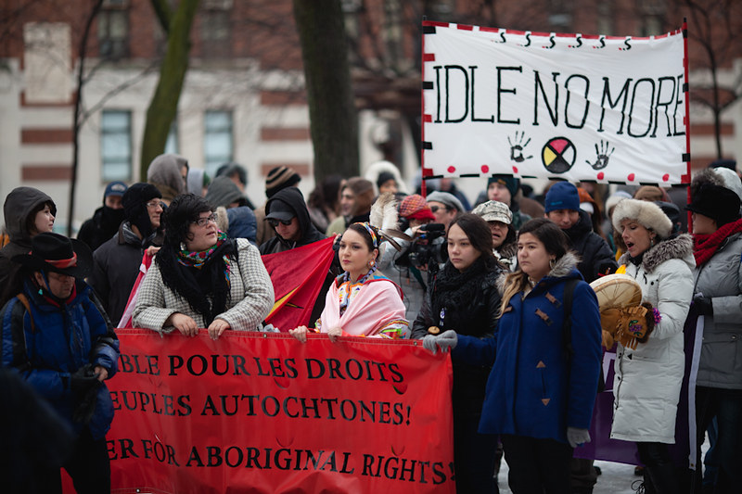
Idle No More
Responded to an immediate problem
Carried out by citizens
Offered solutions to make the country better for all members
​
In 2012, four women from Saskatchewan started a protest movement against a government policy that made it easier for the government to push through projects like pipelines without taking the Indigenous rights into consideration. The movement, called Idle No More, supports environmental protests and Indigenous rights.
Source: CDN Encyclopedia

Slide 6
VOTING
To be eligible to vote in an Ontario election, you must be:
18 years of age or older;
a Canadian citizen; and
a resident of Ontario.
Voting is an important part of democracy. It is a way citizens can participate in the democratic process. Citizens vote for political candidates to represent their interests.

Slide 7
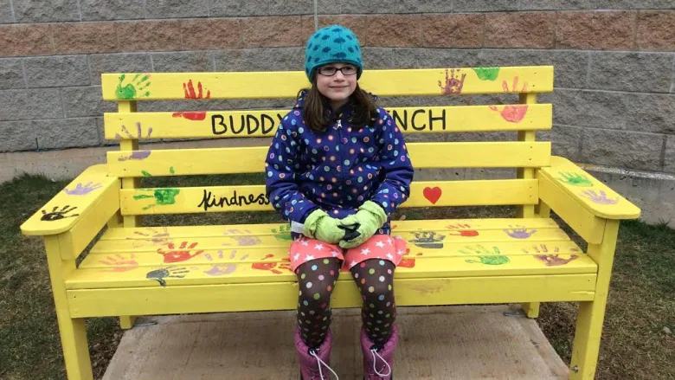
Buddy Bench
​
In 2016, an elementary school in Nova Scotia installed two buddy benches in the schoolyard. A local carpenter built the benches, school volunteers installed them on the playground and students helped paint them. The school guidance counsellor led sessions where she explained to students the bench is for when kids who are feeling lonely and need a buddy. When other kids see someone on the bench, they can invite them to play or sit and talk.
Source: CBC

Slide 8
Turn and Talk
Have you ever participated in a civic action?
If so, explain the action and what you did.
If not, which actions that you just learned about appeal to you? Why?

Slide 9
Thank you!

